Slide 1
Unit 203: Electrical installations technology
PVC cables

Slide 2
PVC cables
PVC comes in two main forms:
thermoplastic
thermosetting.

Slide 3
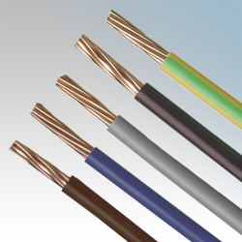
PVC cables
PVC single core (6491X)
This cable comes in sizes from 1.0mm² upwards and usually has stranded conductors, although single strand ‘solid’ conductor cable is still available.
This type of cable requires additional mechanical protection and is generally installed in conduit and trunking.
It is generally found in commercial, industrial and agricultural installations.
A range of insulation colours are available to facilitate cable identification.

Slide 4
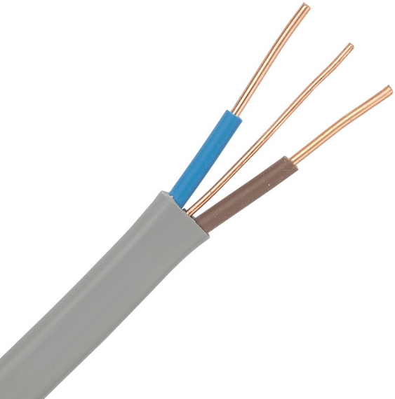
PVC cables
PVC insulated PVC sheathed flat twin and cpc (6242Y)
This cable comes in sizes from 1.5mm² upwards; 1.5mm² and 2.5mm² having solid conductors, and larger sizes have stranded conductors.
The sheathing provides some mechanical protection for the cable and it can be clipped directly to a surface without any other protection in less onerous conditions.
It has PVC insulated conductors and an uninsulated cpc conductor.
Flat three core and cpc (6243Y) is also available, as is single core and cpc.
It is generally, but not exclusively, used for wiring domestic installations.

Slide 5
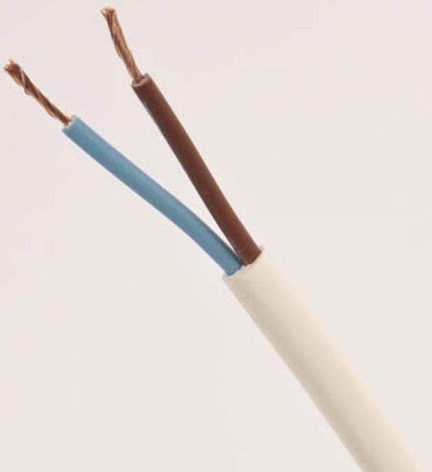
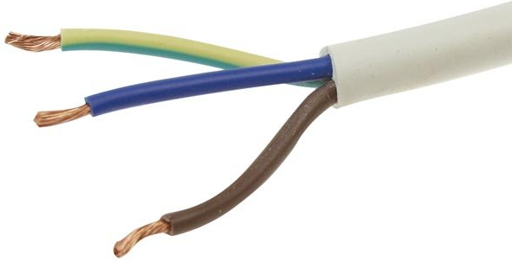
PVC cables
PVC insulated PVC sheathed flexible cable (3092Y and 3093Y)
This cable comes in sizes from 0.5mm² upwards.
Each conductor is made up of many fine strands which make the cable much more flexible.
The sheathing provides some mechanical protection for the cable.
Whilst two- and three‑core cables are the most common, this type of cable is available with many cores.
It is generally used for connecting portable appliances to the socket outlet and for connecting lighting points, eg pendant ceiling rose.
In order to ensure that all the strands are clamped by the terminal, they should be twisted together before termination to avoid ‘whiskers’, ie odd strands that miss the termination.

Slide 6
Unit 203: Electrical installations technology
The End

